Slide 1
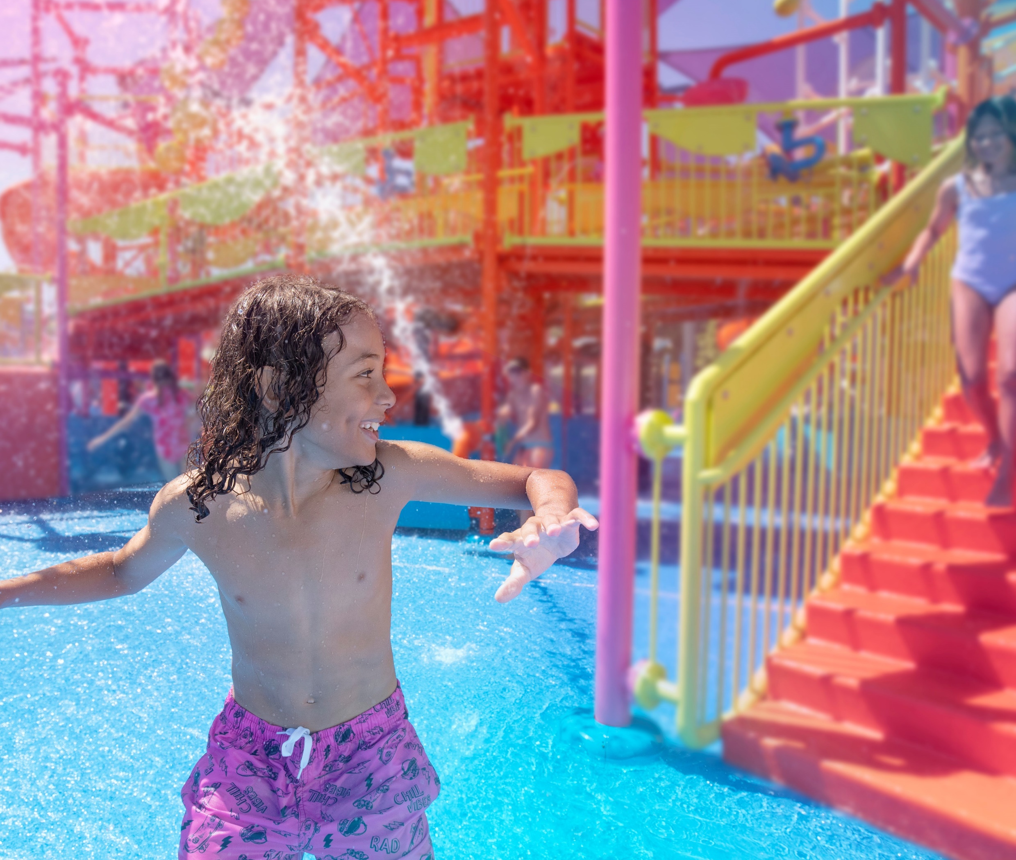


DREAMWORLD AMBASSADORS &/OR MEMORY MAKERS (Ask Community for name)
Culture isn’t just what we do, it’s who we are
Notes:
Learner Guide
Contact points
Setting up their Dreamworld Email address into outlook
Housekeeping
Ultimately what we are wanting to create is some brand loyalty, whilst also weaving in the expectations of them in their new roles. Making them feel part of the story.
86% of new hires are casual or seasonal casual, meaning we have a small window to really sell them who they are and why we should be a part of their lives. A problem worth solving is also ensuring all of their onboarding is completed prior to the induction/welcome to the wider team as at the moment I wouldn’t want to put a budget to how much time leaders are having to put into chasing mandatory training. Drawing a line in the sand of where we were in terms of mandatory training completion prior to starting, and feeling like we are chasing, to be on top of it and managing the renewal training more effectively.

Slide 2
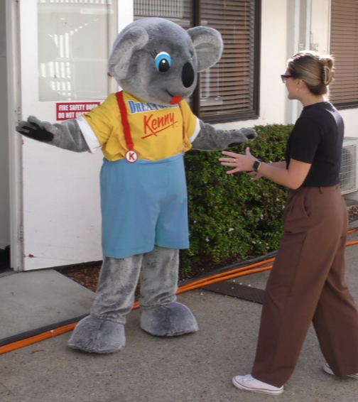
The Opportunity: Make The Induction Great Again.
(but without the red hats or Elon…)
Create an induction that excites, educates, and empowers.
Really align to Dreamworld’s mission & values.
Strengthen safety culture, Activ8 and guest experience.
Notes:
Also weaving in some of the key competencies, values, mission and vision and Activ8 safety strategies.
The new staff members will have their names up on the screen at the start with a big welcome
Have a present in the middle of the room with some goodies for each team member (even just a t-shirt)
It will be catered for the length of time that is decided upon.

Slide 3

12 Month Learner Group
Contract: 85% of staff are casual or seasonal casual
Total hires: 2024 saw 460 Team Members hired
Demographic: average age was 25, although ranged from 14 – 64
Average Cost: $31 per hour
Notes:
Also weaving in some of the key competencies, and Activ8 safety strategies.

Slide 4
The Three Induction Models (Overview)
6 HOUR IMMERSION
Builds further on Engagement
More hands-on team building Experiences
Greater immersive learning opportunities
4 HOUR ENGAGEMENT
(recommended)
Builds on essentials
Adds Team Building Activities
Scenario based learning
Character Creation
Practical Application
Gamification
Ceremony
2 HOUR ESSENTIALS
– Fast-Track –
Safety & Compliance
Dreamworld Journey
Key Expectations
Minimal interactive elements
30-minute Park Activity

Slide 5
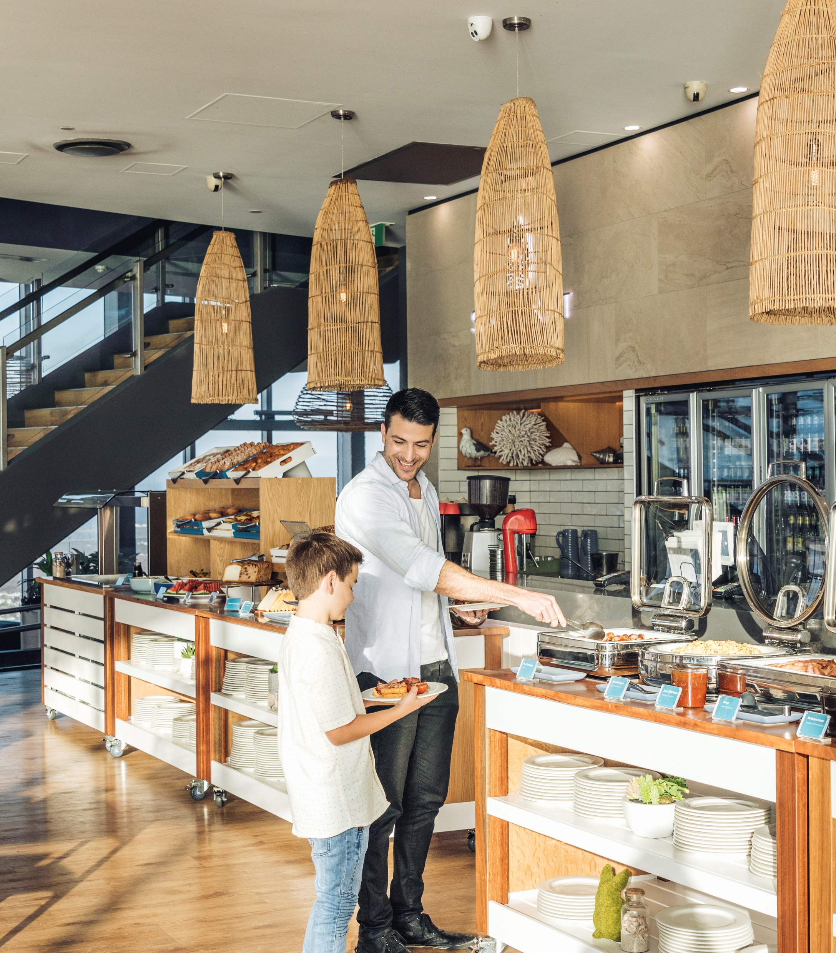
Cost breakdown
Average Cost Per hour (23/24 staff) $31 per hour
Estimated Time for Induction 2/4/6 hours
L&D Facilitator - $37 p/hour 2/4/6 hours
Department Leaders - $45 p/hour 2/4/6 hours
Average Staff Per Fortnight (23/24 YTD) 18
Average Cost Per Fortnight Induction
2 Hour essential
$1,280 (2 x 18 x $31) + (2 x $37) + (2 x $45)
4 Hour engagement
$2,560 (4 x 18 x $31) + (4 x $37) + (4 x $45)
6 Hour immersion
$3,840 (6 x 18 x $31) + (6 x $37) + (6 x $45)

Slide 6
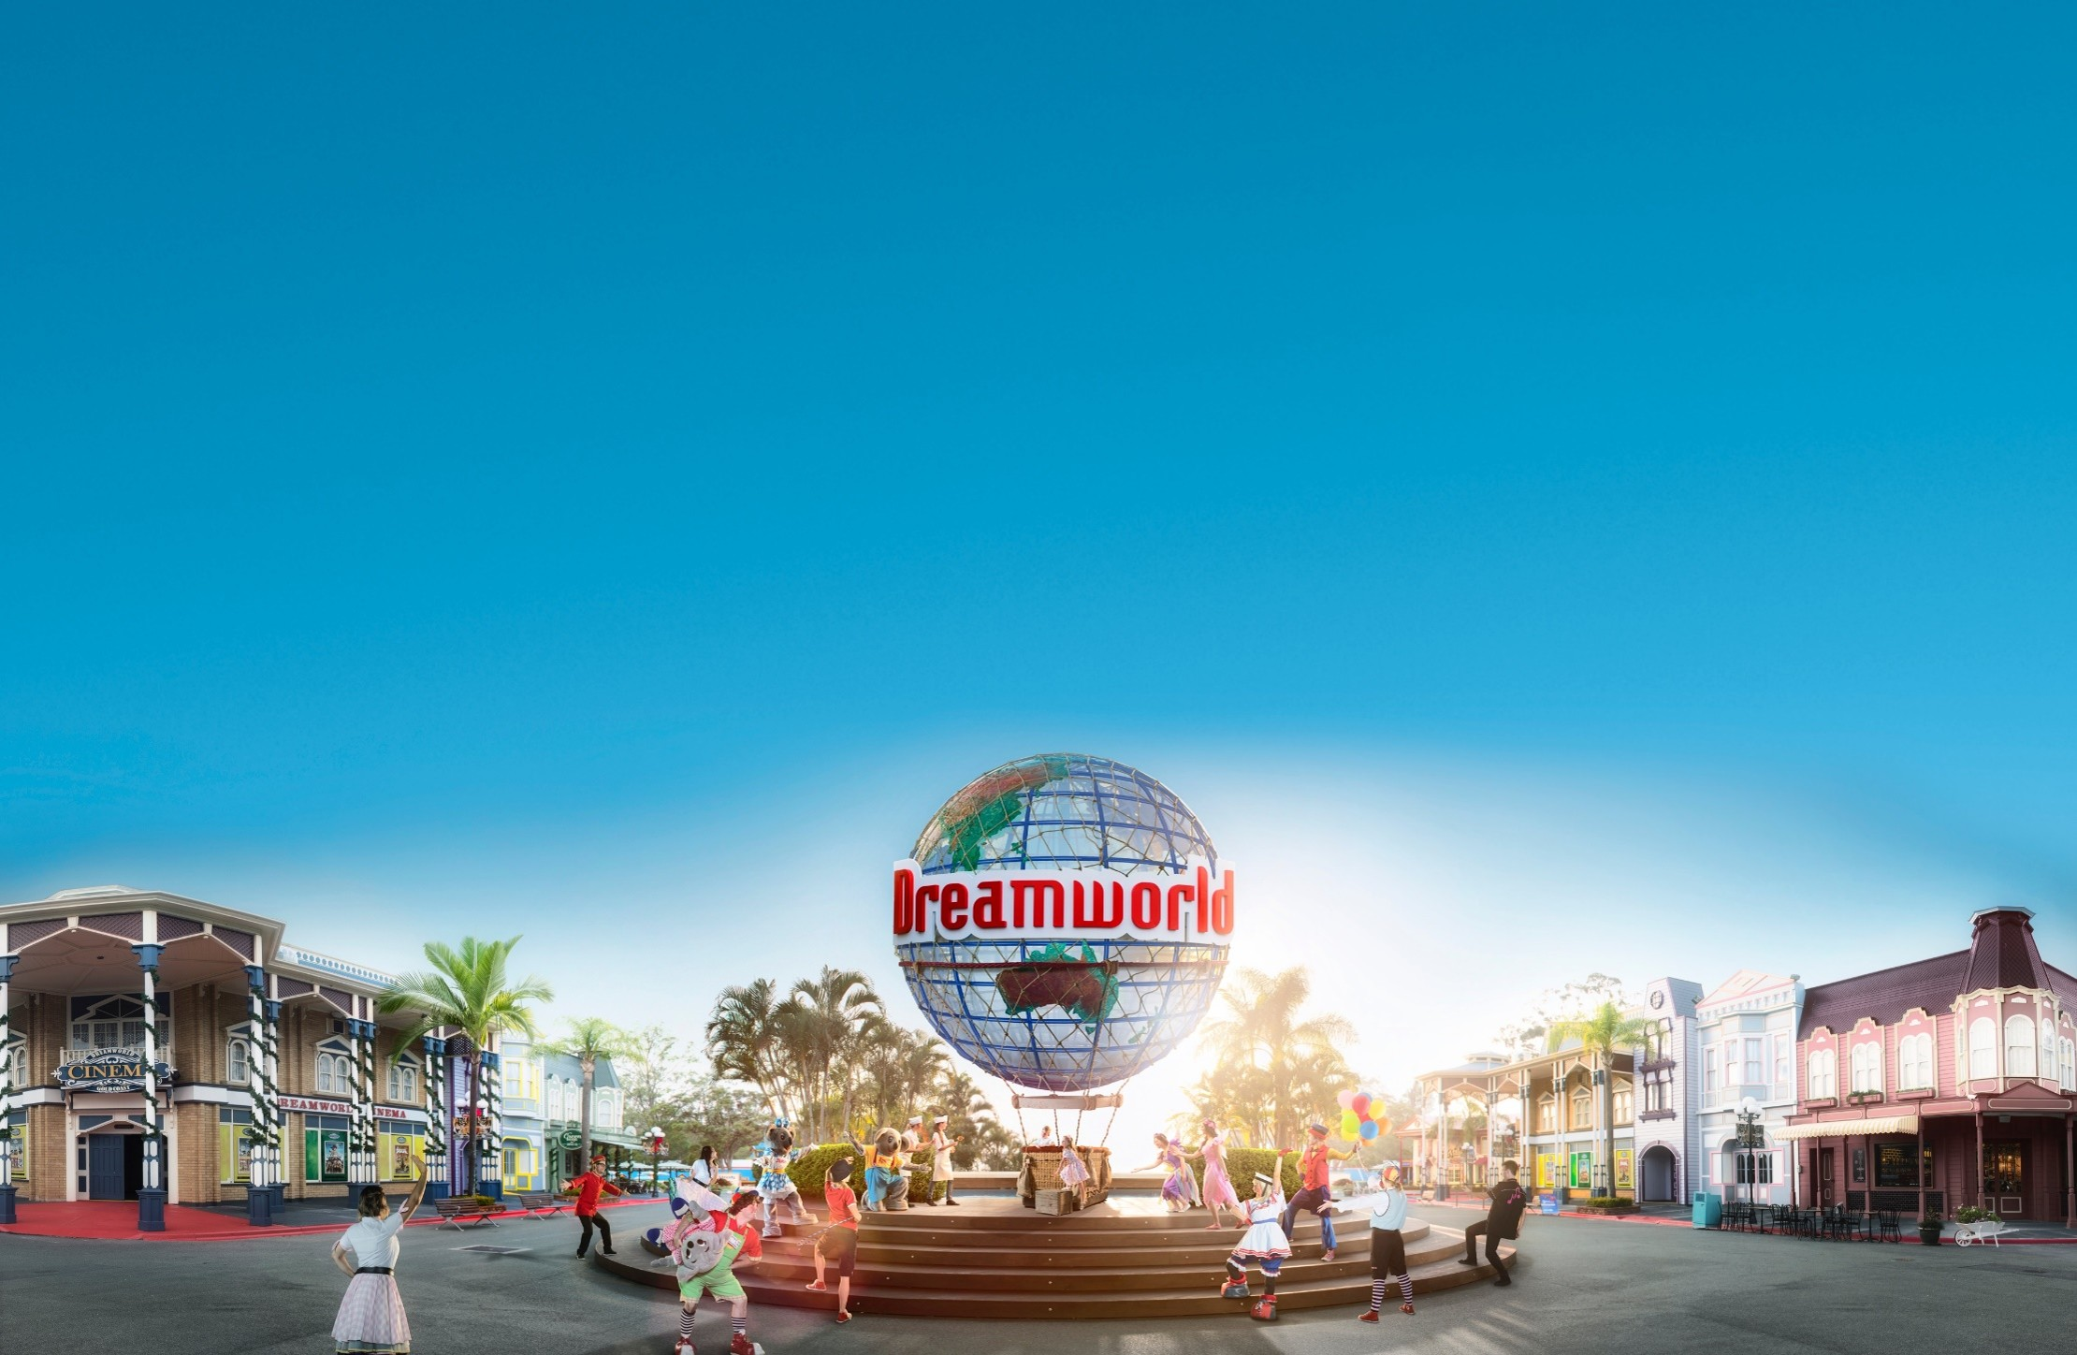
ROI/Feedback
Program feedback should highlight understanding of:
The vision, mission & values
Enjoyment of the induction
Team building
The future & their role
Feel closer to the brand
Would you Recommend a Friend
Survey from forms (6 Questions) sent to all inductees for them to complete at closure of the course
Notes:
Focus group trial – changing the day around – any amendments like Kenny and Belinda at start or end

Slide 7
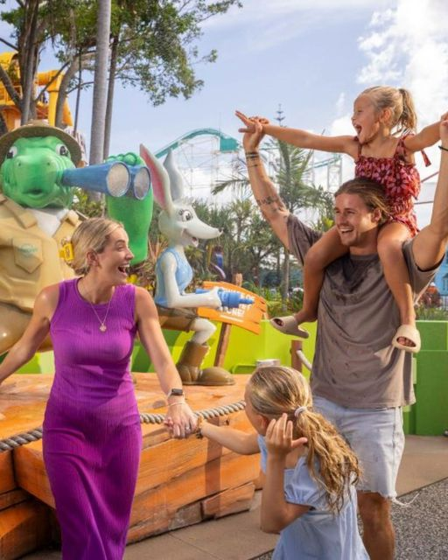
4 Hour Engagement Example
What will be covered?
Welcome to the Dreamworld Family
Dreamworld Today & the Future
Safety
The Dreamworld Experience; What sets us apart
GUEST Experience
Behind the Scenes: How Dreamworld Operates
Your First Day
Systems, Tool and Career Opportunities
Employee Benefits & Culture

Slide 8
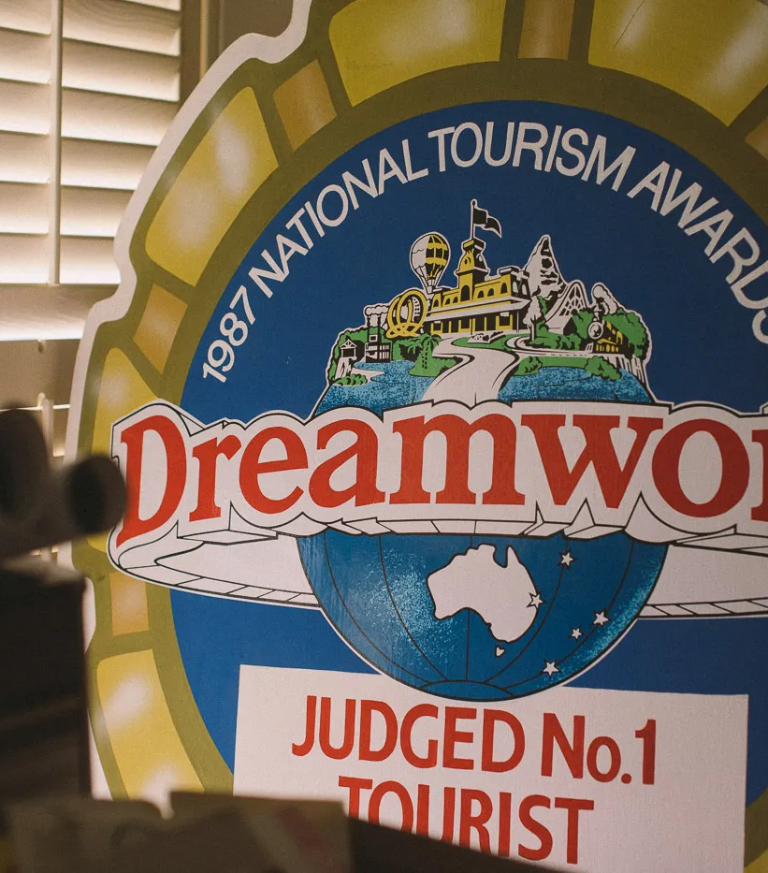
Their role in the Dreamworld Story… Our cast of characters
ONLY IN 4/6 hour Induction
THE EXPLORER - Representing our Guests Services, retail, Attractions & Aquatics Embodying curiosity and Customer Connection
THE GAURDIAN – Representing Safety, protecting both guests, staff our ourselves
THE CREATOR – Representing Innovation, We want to hear from you… ensuring every moment is memorable
THE MAESTRO – The conductor of fun and festivities. They inspire others to join in and create a harmonious vibe of collective happiness.
Notes:
Every staff member has a role they can play… Dreamworld is a living evolving story where everyone plays a vital role in creating memories that last a life time… helping Dreamworld achieve its vision as the best themepark in Australia
Which character resonates with you and why?
Ultimately what we will be trying to achieve throughout the induction is that these characters will show up in their roles throughout their working time in dreamworld/SkyPoint.
We will be exploring and actively getting them to view the departments etc through the lens of these characters. That whils they may identify as one or some of them, all of them are important.
Lead into the Vision, Mission and Values

Slide 9
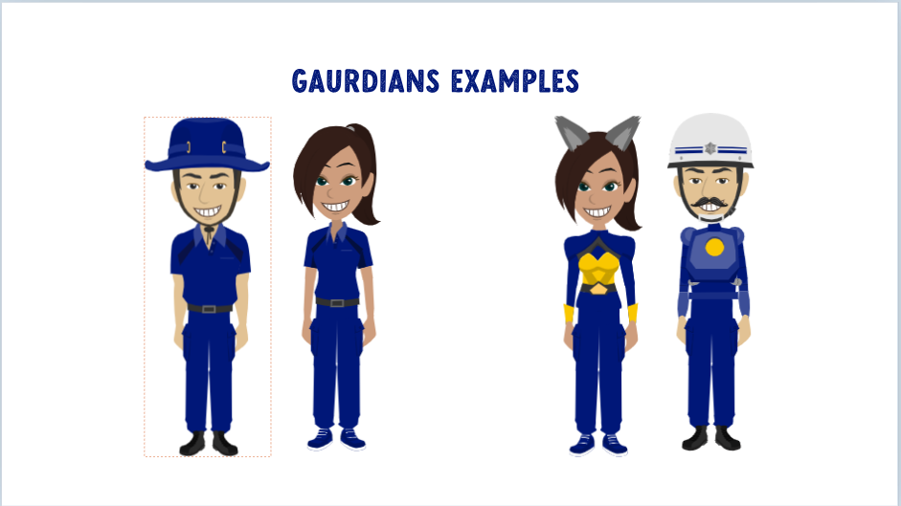
ONLY IN 4/6 hour Induction
Notes:
ACTIV8 – bring in and associate with the characters.

Slide 10
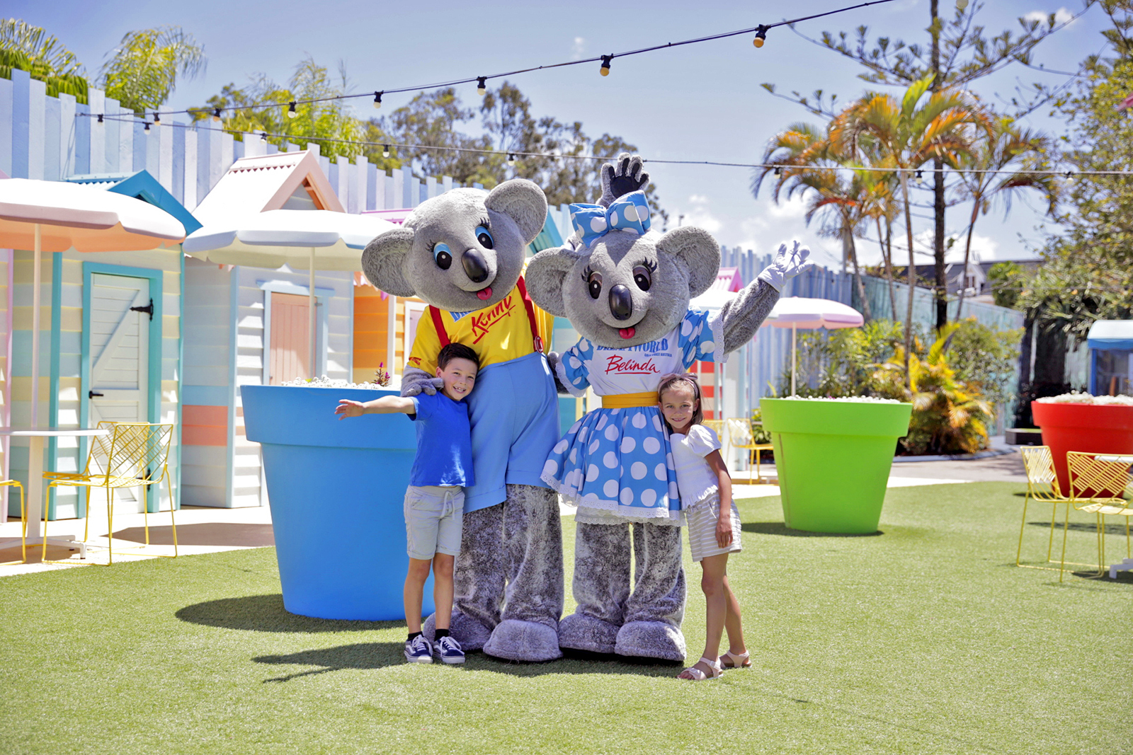
Create Happy memories that last a lifetime!
The Dreamworld Difference
Notes:
Content:
We want our guests to…
Feel genuinely welcomed
Experience exceptional service
Feel safe
Take away a memorable experience
Activity: Kahoot – also a talk done by one of the Commercial/F&B/Guest Services team?
GUEST Service is an interaction that exceeds an individuals expectations and leaves them with a positive impression.

Slide 11

Notes:
I haven’t put any audio to this yet. But also including some of the people/characters they will see in the animations in the training in Evolve

Slide 12

Group Activity Example Activity Outline: "Discover Dreamworld Challenge"
Step | Description | Execution Details
Team Formation (5 min) | Split participants into diverse teams (mix of roles, personalities). Provide a team name and color. | - Hand out small flags, stickers, or themed accessories for team identity.
Park Exploration (20 min) | Teams complete a scavenger hunt-style activity across key areas of the park. | - Give clues or tasks that tie into Dreamworld’s history, attractions, and values. - Examples: “Find a spot with a koala statue and take a team photo” or “Name the year Dreamworld first opened.”
Quiz Show with Kahoot! (10 min) | Teams return to a central meeting point for a high-energy Kahoot! quiz about the park. | - Questions could include fun facts, cultural insights, or highlights of Dreamworld attractions. - Offer small prizes (e.g., Dreamworld-branded merchandise) for the winning team.
Notes:
Why This Works:
Immersion Through Storytelling: Using brand history and values to create emotional connections. The scavenger hunt includes questions and activities that tie new staff to Dreamworld's heritage and its mission.
Team Bonding: We need to create team-building games that require collaboration, ensuring that staff feel like they’re part of a supportive community from day one.
Interactive Learning: Kahoot! quizzes align with our focus on fun, interactive learning. It’s fast-paced, engaging, and perfect for younger staff.

Slide 13
ONLY IN 4/6 hour Induction
Activity: Living Our Mission Workshop Objective: Internalise Dreamworld’s mission and values through role-playing . Duration: 15 minutes
How It Works:
Group Assignment: Divide staff into teams and assign each a core values (e.g., safety, Innovation & efficiency, fun & celebration, great service & general performance).
Scenario Role-Play: Provide real-life guest scenarios for each group to act out.
- Example Scenario for “Safety”: A guest loses their phone on a ride.
- Example Scenario for “Great Service”: A child is too scared to ride the Big Red Car.
Showcase & Feedback: Groups perform their skits, followed by facilitator feedback connecting their actions to the mission.
Why It Works: Embeds Dreamworld’s mission into day-to-day behaviors.Boosts confidence in handling guest interactions.

Slide 14

Mastering the GUEST Experience
G
Greeting
E
Efficiency
T
Thankfulness
U
S
Understanding
Safe
Notes:
It is the theatre that help create memories – the guest experience is the show, and we are the cast…
We have our on stage role, which is when we open the doors to the public, and your interaction with them… and we have our offstage role, all the preparation, collaboration and focus behind the scenes.
Remembering the lens of the three characters and how they may show up as part of the Guest experience.

Slide 15
Behind the Scenes
“THE HEART OF DREAMWORLD OUR DEPARTMENTS”
Content will explore the departments, department heads and how it all pulls together.
Notes:
Shane Boys – Engineering – Heritage info
I was thinking about getting a few pictures of people working around dreamworld and putting together a montage.
The plan within the all engagement or all immersion is to weave the characters, the explorer, the guardian, the creator through the departments showing how their dreamworld storyline will cross all of the main characters

Slide 16

Personalising the content
Creating short videos of team members;
what dreamworld means to them,
why safety is important,
Food recommendations,
helpful tips from current staff that will make their first few months simpler.
Hints from leaders
VOXPOPs
MAINLY ONLY IN 4/6 hour Induction

Slide 17
Flow on to Departmental Inductions
Revamp of current induction slides to follow on from the all-staff induction.
Reduce duplication
Allow them to focus purely on their department needs
Assist in development of the slides for the departments so messages are matching the all-staff induction

Slide 18
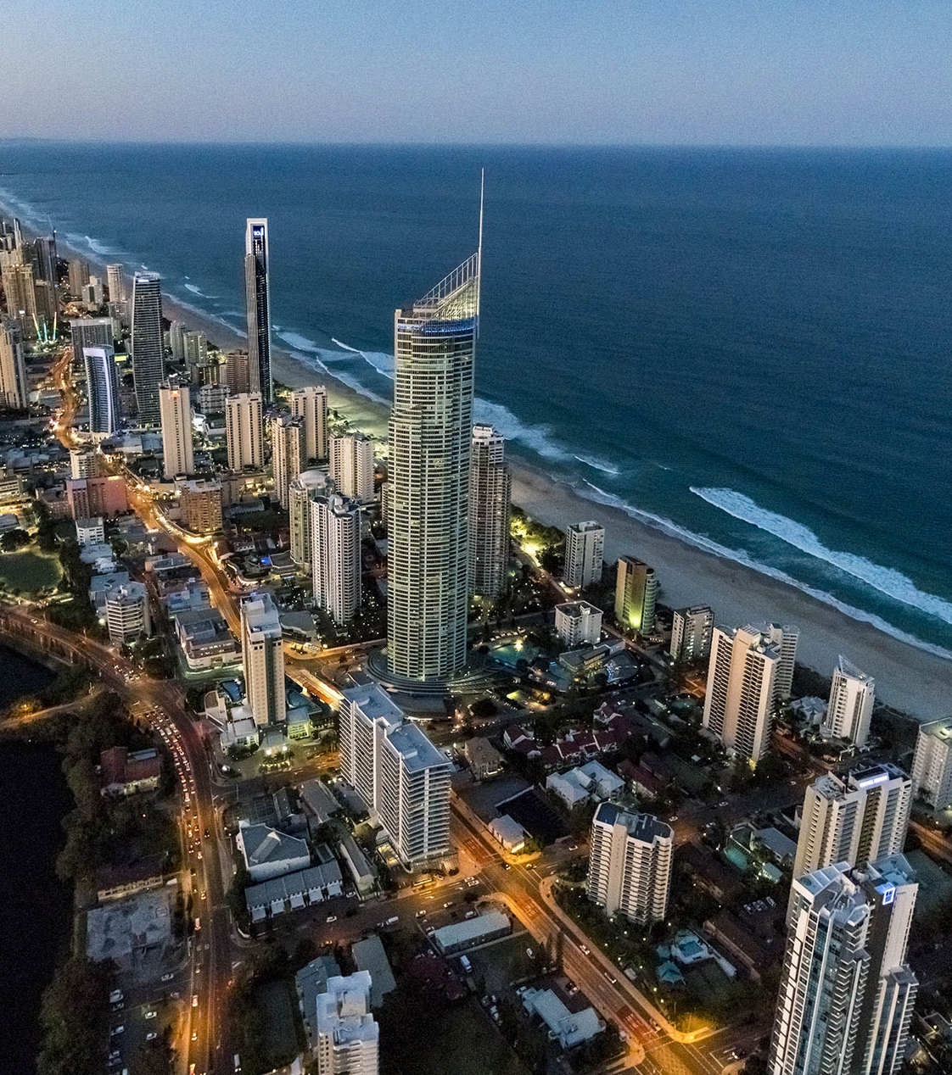
Prizes and Giveaways
Would be awesome to give them some gifts to walk away with like:
T-shirts
Coffees
Hats
Pictures with Koalas
Dreamworld Day Pass
SkyPoint climb
Any Merchandise
Perkbox Points
Pocket Sized Book of dreamworld facts and locations for new staff to keep on them for guest interactions
Learner Guide

Slide 19
Next Steps
Focus Group trial
Adjust the content on feedback received
Honest feedback survey covering off:
Covering The vision, mission & values
Enjoyment of the induction
Team building
Amendments
4. Base facilitator + 1 manager that changes for each induction session
5. Completion of training slide deck & facilitator notes
Voxpops of staff
Agreement on what we can giveaway/prizes
Mock scenarios (if 4/6 hour Presentations)
Notes:
Focus group trial – changing the day around – any amendments like Kenny and Belinda at start or end

Slide 20
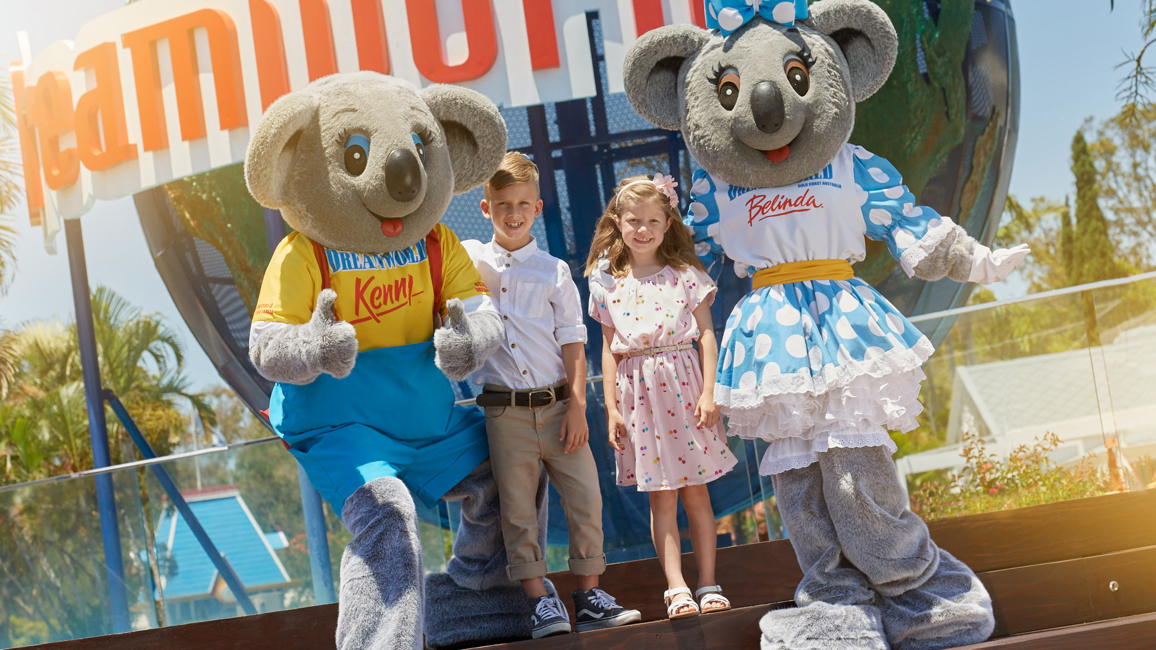
“The Future of Dreamworld Starts Here, welcome to the Dreamworld Family”

